Slide 1

DriverPass System Analysis
Michael Wood
Notes:
[No speaker notes required for this slide.]

Slide 2

System Requirements
Two Functional Requirements
The ability for users to chose from three driving lesson packages
Allowing students to book their driving lessons through the portal
Two Nonfunctional Requirements
System Performance
Adaptibility
Notes:
The system's workflow or features are depicted by nonfunctional requirements, whereas functional requirements give light on how the system should execute particular processes.
One of the two specified functional criteria is the ability to provide consumers with three different driving packages to choose from. After logging into the DriverPass portal, customers will be able to choose from three various packages offered by our client. The consumer will be redirected to a new page asking for payment details after clicking the hyperlink. The consumer can begin booking their driving lessons once they pay the amount mentioned for the package they selected. Two, the system must enable students to schedule driving lessons through the site; this is a functional requirement. After a client enters their login details, they will be able to see their calendar and choose a time and date to book a driving lesson. The calendar will show blocked lessons to avoid multiple bookings of reservations.
Our system's nonfunctional requirements must be considered next. Flexibility is our primary nonfunctional need. From an administrative and information technology perspective, it is crucial to ensure that all data is housed on the "backend," where only authorized individuals may access it. In this scenario, the data will only be accessible to the administrative staff within IT. Everything that is accountable for keeping this system up and running, such as the server it is hosted on and the database that contains all sensitive data, will be accessible to the IT administrator.
The efficiency of the system is our second nonfunctional criterion. Your request for a web-based cloud environment is what we take it to mean as the customer. As your business evolves and expands, you can easily adjust the system's capacity to meet your needs at a reasonable cost. Users should not have to wait extended periods of time to click on links because the system is designed to have minimal lag time. Regular system updates—every two weeks or once a month—to keep it running well and meet your company's requirements.

Slide 3
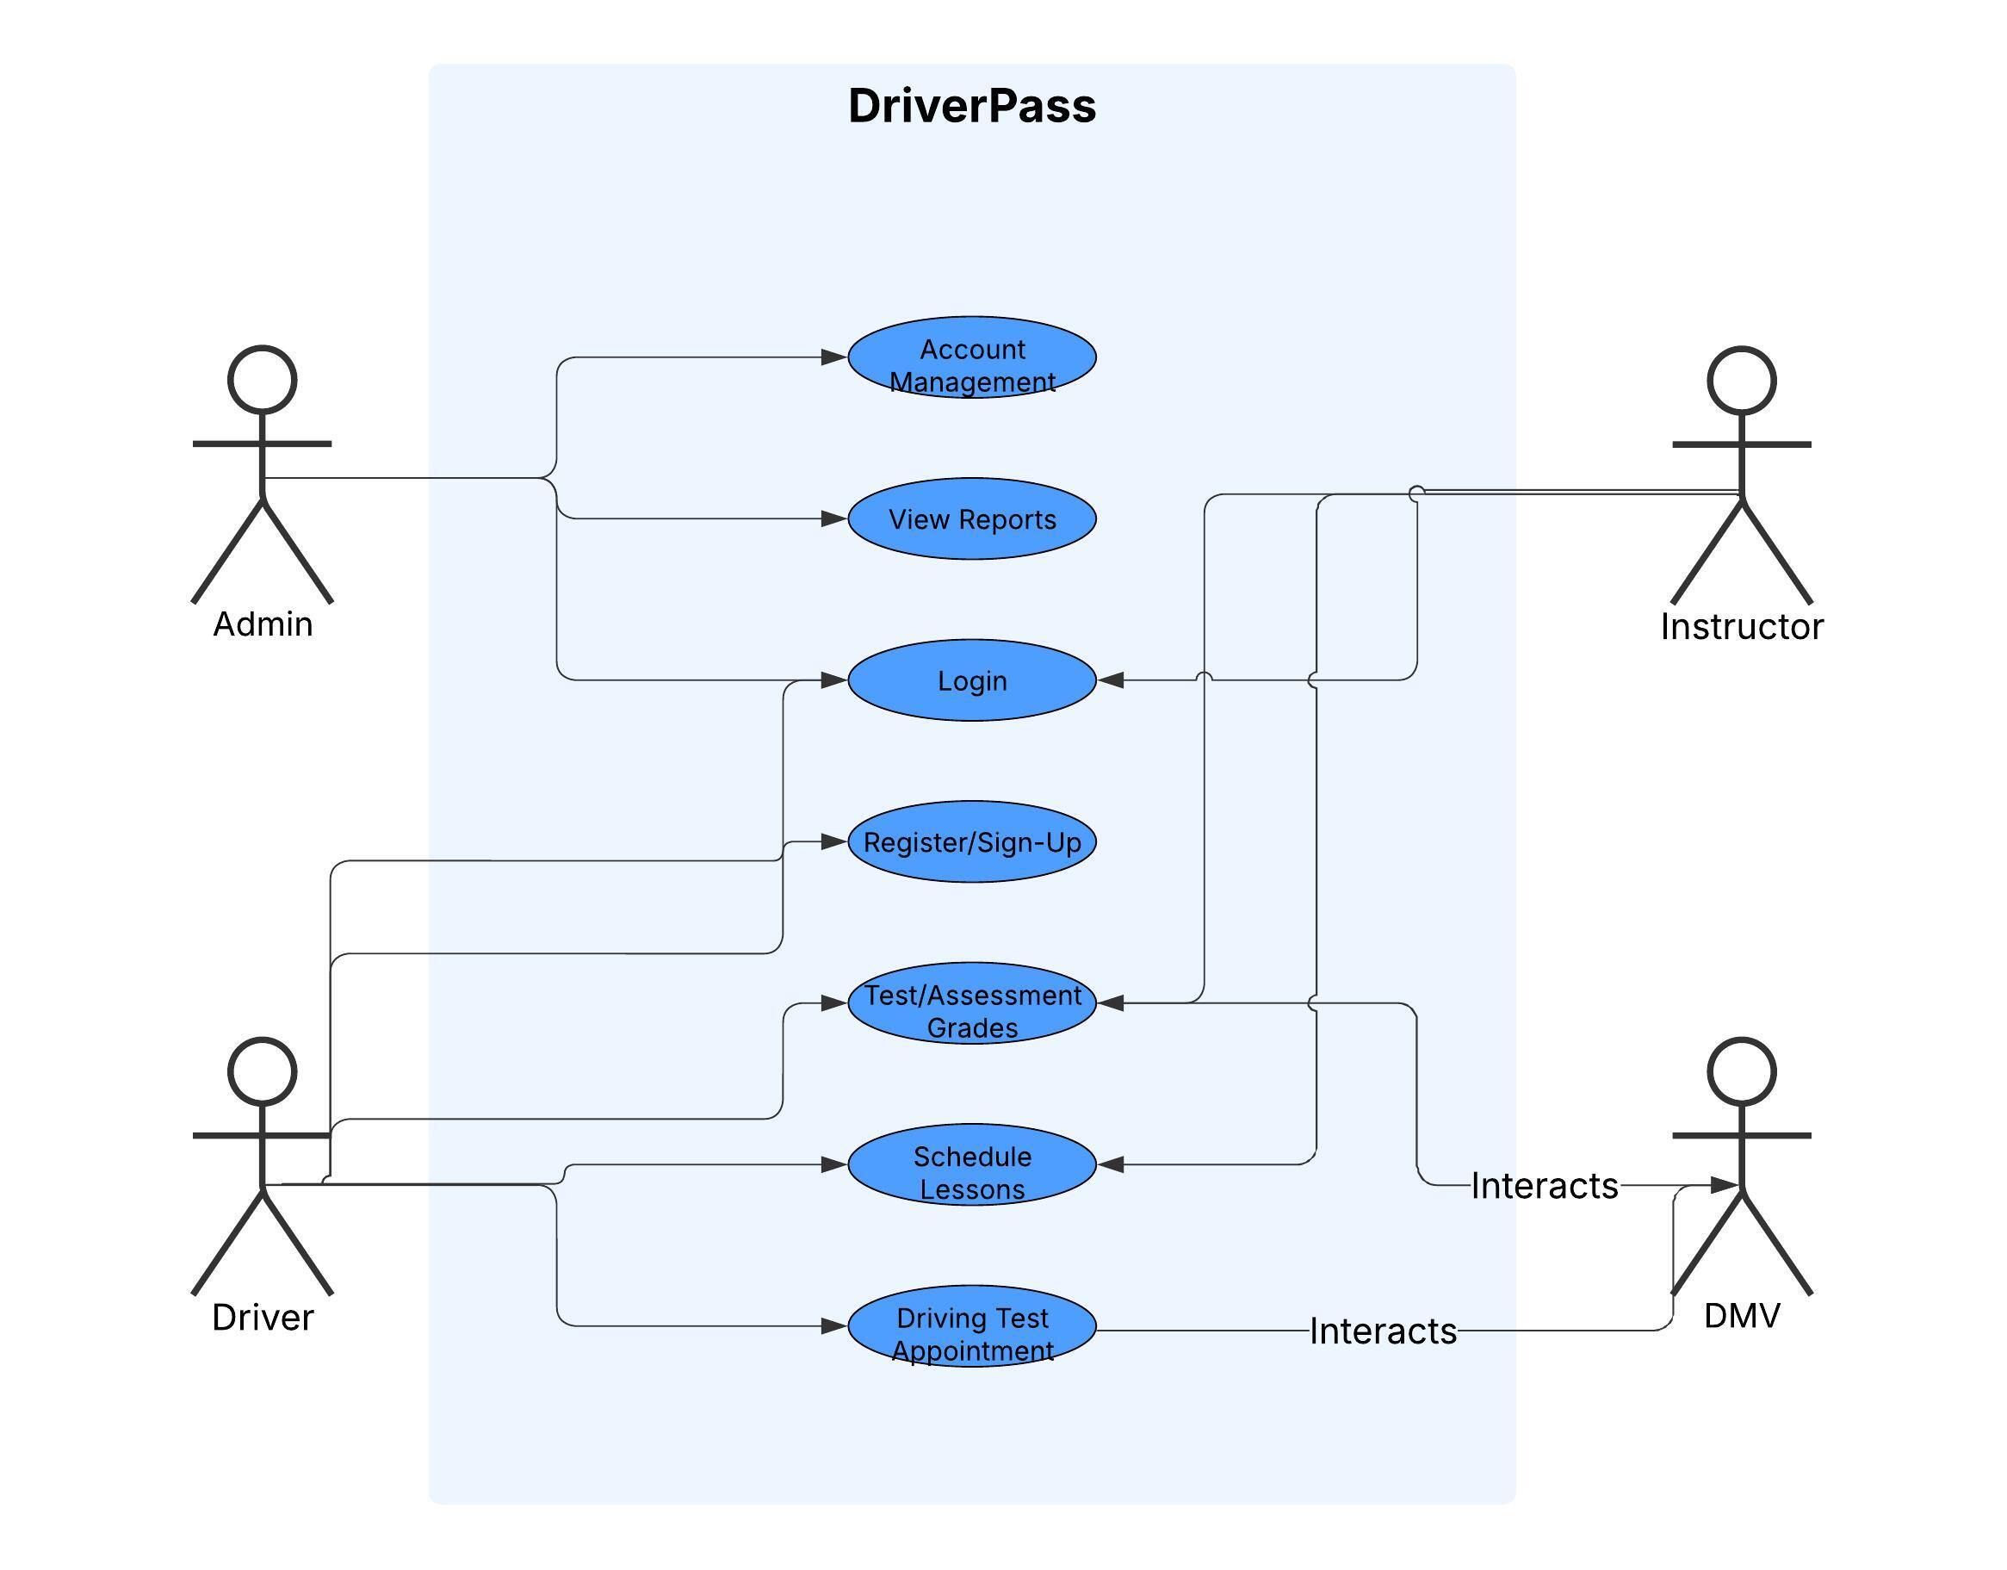
Use Case Diagram
[Insert your use case diagram here.]
Notes:
Customers, you, the admins, and instructors will all be considered "actors" in this system. Users can sign up for an account, schedule and edit appointments, see instructor lesson notes, contact customer service, and change their passwords. The ability to run reports, receive policy updates from the DMV, and reset customer passwords will be available to administrators. It will be possible for the instructors to handle appointment scheduling. We made sure to include all of your specifications when creating this diagram, so you can completely understand how it should work.
You can use it to estimate the capabilities of the system in terms of the tasks that users can complete. Naturally, since everyone will have their own login, they will only be able to access the information that has been granted to them. To give just one example, instructors can only ever handle appointment management and lessons. They are not authorized to access customers' credit card details, and consumers can only access the information that is available to them in their account after they log in with their unique credentials.

Slide 4
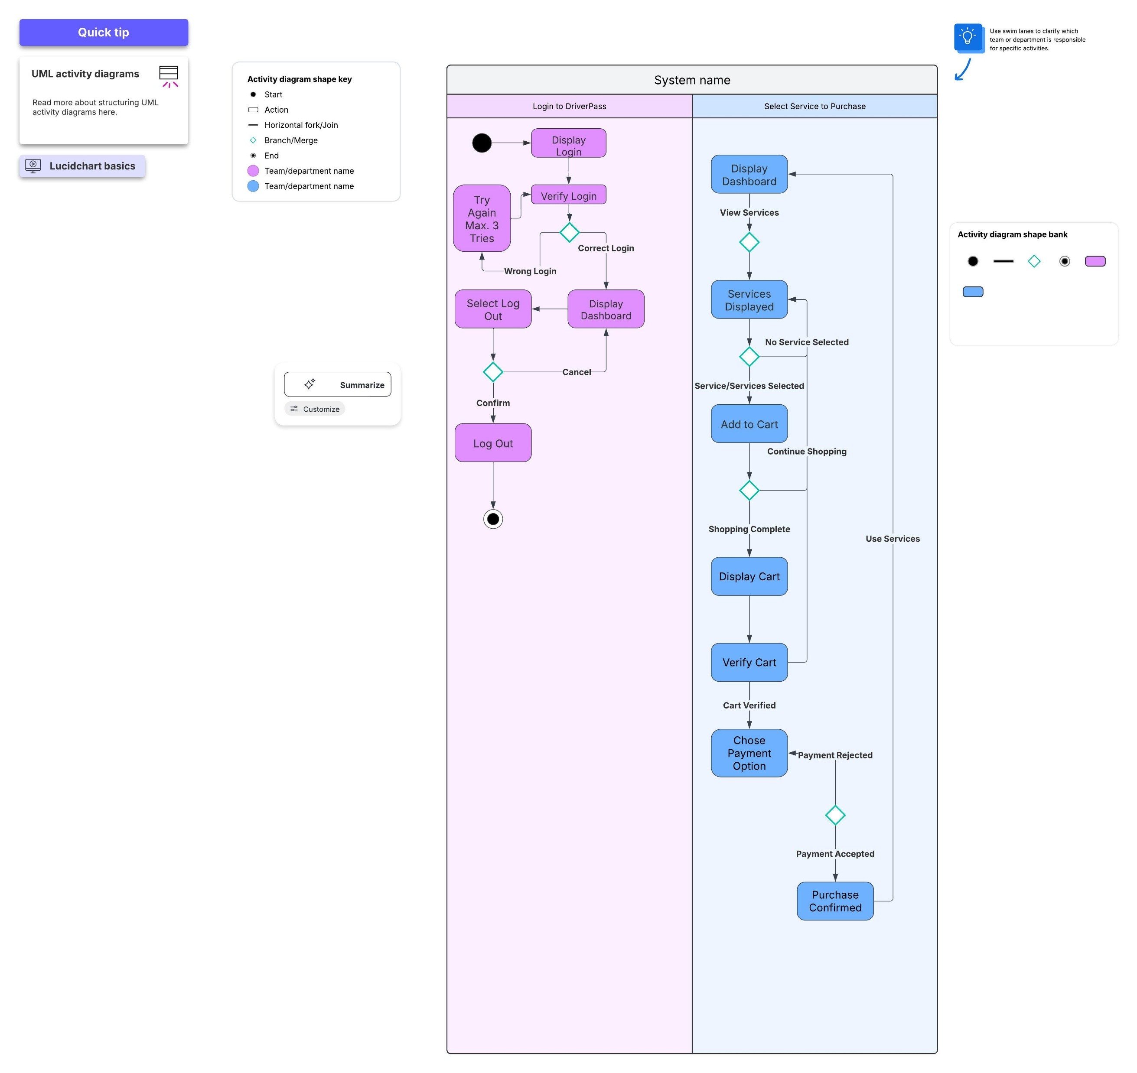
Activity Diagram
Notes:
This is a mockup of logging into the DriverPass application and selecting a service to purchase. On the left hand-side you will see the mockup of the Log In to DriverPass app which shows two of the security protocols that will be in place a login verification with unique username and password along with a maximum of 3 tries before lock out occurs, in which you would have to contact an admin to release of your account. This helps keep fraud at a minimum. If you look to your right in blue, you will see the mockup of purchasing services. It will allow you choice of three then take you to the cart, allow you to verify that the cart is correct, then move on to payment options. Once you chose you payment and it has been confirmed it will take you back to the dashboard where you can start using your newly purchased product. If for some reason payment is not confirmed it allow to go back and change payment option or try again.

Slide 5
Security
Multi-Factor Authentication (MFA) Basically, you will use another device in your possession to verify who you are.
Limited Login Attempts
Case-Sensitive Passwords created by User with a minimum length, and special characters capitals must be included within the chosen password.
Notes:
Having settings specified for each user's login is one of the greatest ways to put security measures in place. In order to access their DriverPass accounts, all users, including administrators, will require a unique login. The username must be a personal email address, and the password must be a unique, case-sensitive phrase that must include capital and special characters with a thirteen character minimum. Security measures, such multi-factor authentication, will be put in place to guarantee the safety of sensitive data, like clients' street addresses and payment card details or your administrative team's access to reports and reservation details. To put it simply, multi-factor authentication ensures that the user claiming to access an account is actually that person. A secure passcode will be issued to the customer's device via email or text message in order to accomplish this. When a user logs in, they will see a link to change their password. If they do not want to wait for an administrator to do it, they can use the self-service link. You should also set a maximum number of times a user can try to access their account. Your ability to log in will be disabled after three failed tries. The IT administrator can unlock it from their end, making sure no hacking attempt has occurred.

Slide 6
System Limitations
Time
Resources
Technology
Budget
Notes:
Time is our initial constraint. We only have from January 22nd to May 10th to complete this system, thus we must effectively manage our time and organize each work.
The budget is contingent upon the budget of our client, you. We are limited by technology and resources. Both are dependent on your budgetary limits.
The amount of office and administrative team hardware that can be purchased is limited. Our clients' resources may also be restricted by technologies, such as outdated mobile devices that are incompatible with our system's browsers. Resource restrictions, including the quantity of experienced technical staff you may employ to develop your system and the efficiency you desire, are determined by your budget.

